Slide 1
Chapter 4 Starting to Use Unix
Hadeel Ammari, M.C.Sc, MBA
Computer Science Instructor, Foothill Collage

Slide 2
Main Topics
The System Administrator
Userids and passwords
Logging In (Starting Work With Unix)
What Happens After You Log In?
Getting Down to Work: The Shell Prompt
Logging Out (Stopping Work With Unix): logout, exit, login
Upper- and Lowercase
Changing Your Password: passwd
Choosing a Password; Hackers and Crackers
Checking If Someone Has Been Using Your Unix Account: last
Userids and Users
The Superuser Userid (root)

Slide 3
The System Administrator
A system Administrator is the person who administrator and maintain a Unix systems (SYSADMIN or ADMIN)
There are two ways to access a Unix system:
Your own Unix system
A shared multiuser system

Slide 4
Userids and passwords
Before you can use a Unix computer, you need:
Userid: a name you will use to identify your self to the system
Password
An account is permission to use a Unix system
Keep track of how much you use the system.
Certain predefined limits, such as how much disk space you are allowed for your files, or how many pages you can print.
Expiration date

Slide 5
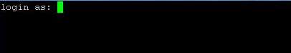
Logging In (Starting Work With Unix)
How to log in to your Unix account?
Enter your userid and press <RETURN>
Enter your password and press <RETURN> (Passwords are not echoed by the host)
If login incorrect, you get a specific number of tries (3-5) and then get disconnected.

Slide 6
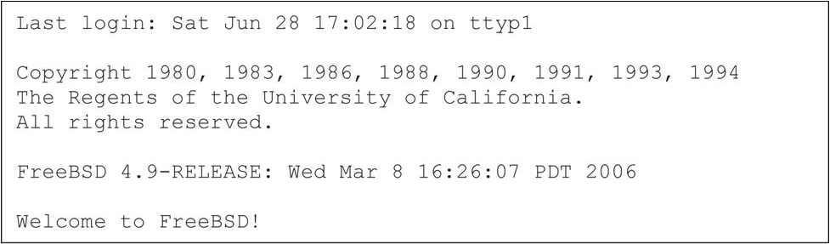
What Happens After You Log In?

Slide 7
Getting Down to Work: The Shell Prompt
Log in
Initialization
Unix starts the shell and pass control to it
The shell displays a prompt and wait for commands
User enters a command and press <RETURN>
The shell will process the command usually by starting a program and pass control to it
When program terminate control goes back to the shell
Log out

Slide 8
Getting Down to Work: The Shell Prompt
Shell prompt for bash and Korn
Shell prompt for C-Shell
Commands to try
$
%
$date
$whoami
$who
$w

Slide 9
Logging Out (Stopping Work With Unix): logout, exit, login
When logging out, Unix will stop your shell and end your session.
How to log out?
<Ctrl + D> (sends an eof signal)
Logout <RETURN>
exit <RETURN>
Login <RETURN> (not safe)

Slide 10
Upper- and Lowercase
Unix is case sensitive; it distinguishes between capital letters (UPPERCASE) and small letters (LOWERCASE).

Slide 11
Changing Your Password: passwd
To change your password
You might need to change your password due to password ageing
$passwd

Slide 12
Choosing a Password; Hackers and Crackers
Who is a hacker and who is a cracker?
Hackers are people who spend a lot of time working on useful programming projects.
Crackers are people who take pleasure in trying to break into a system.
To protect your account:
Never tell your password to anyone
Choose a password that is not easy to guess
If you suspect someone knows your password change it right the way
What is a good password?

Slide 13
Checking If Someone Has Been Using Your Unix Account: last
Initial message when logging in shows the last time you logged in.
To check farther use:
To terminate the command press <Ctrl + C>
$last userid

Slide 14
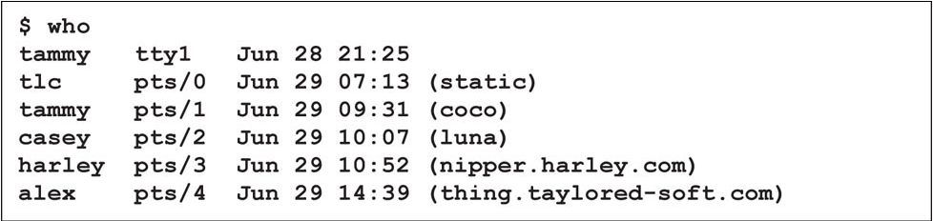
Userids and Users
A user is a person who utilize a Unix system in some way.
Unix does not know about users: Unix knows only about userids.

Slide 15
The Superuser Userid (root)
Unix supports a special user name root (superuser).
root userid has extraordinary privileges .
When logging in using root userid the shell prompt will change to # for all types shells.

